Slide 1
Cryptography
Fundamental concepts of Cryptosystems
Authentication
Digital Signature
Stream Cipher System
Private Key Distribution System
Public Key Distribution System.

Slide 2
Fundamental concepts of Cryptosystems
Aspects of Security
Securityattack:Any action that compromises the security of information owned by an organization.
Securitymechanism:A process that is designed to detect, prevent or recover from a security attack.
Securityservice:A process or communication service that enhances the security of the data processing.

Slide 3
Security Attacks
Passive attacks ‐ attempt to learn or make use of information from the system but does not affect system resources.
obtain message contents
monitor traffic flows
Difficult to detect.
Do not involve any alteration of the data.
Active attacks - attempt to alter system resources or affect their operation.
By modification of data stream to: masquerade of one entity as some other
replay previous messages
modify messages in transit
denial of service
Easy to detect.

Slide 4
Security services
Enhance security of data processing systems and information transfers of an organization
–intended to counter security attacks
–using one or more security mechanisms
–often replicates functions normally associated with physical documents
which, for example, have signatures, dates; need protection from disclosure, tampering, or destruction; be notarized or witnessed; be recorded or licensed

Slide 5
Security services
Authentication‐assurance that the communicating entity is the one claimed
Access Control‐prevention of the unauthorized use of a resource
Data Confidentiality–protection of data from unauthorized disclosure
Data Integrity‐assurance that data received is as sent by an authorized entity
Non‐Repudiation‐protection against denial by one of the parties in a communication

Slide 6
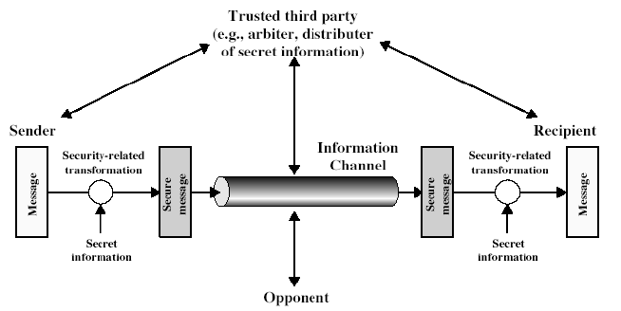
Model for Cryptosystem

Slide 7
Model for Cryptosystem
using this model requires us to:
design a suitable algorithm for the security transformation
generate the secret information (keys) used by the algorithm
develop methods to distribute and share the secret information
specify a protocol enabling the principals to use the transformation and secret information for a security service

Slide 8
Basic terminology
plaintext‐the original message
ciphertext‐the coded message
cipher‐algorithm for transforming plaintext to ciphertext
key‐info used in cipher known only to sender/receiver
encipher (encrypt)‐converting plaintext to ciphertext
decipher (decrypt)‐recovering ciphertext from plaintext
cryptography‐study of encryption principles/methods
cryptanalysis (codebreaking)‐the study of principles/ methods of deciphering ciphertext withoutknowing key
cryptology‐the field of both cryptography and cryptanalysis

Slide 9
Cryptography
can characterize cryptograhic systems in 3 dimensions:
- type of encryption operations used
substitution / transposition / product
number of keys used
single‐key or private / two‐key or public
way in which plaintext is processed
block / stream

Slide 10
Block & Stream ciphers
block ciphers process messages in blocks, each of which is then en/decrypted
•like a substitution on very big characters64‐bits or more
stream ciphers process messages a bit or byte at a time when en/decrypting
many current ciphers are block ciphers

Slide 11
Stream ciphers
process message bit by bit (as a stream)
have a pseudo random keystream
combined (XOR) with plaintext bit by bit
randomness of stream key completely destroys statistically properties in message
Ci = Mi XOR StreamKeyi
but must never reuse stream key
otherwise can recover messages (cf book cipher)

Slide 12
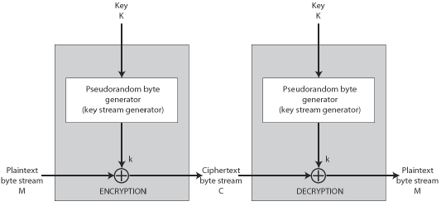
Stream cipher structure

Slide 13
Stream cipher properties
some design considerations are:
long period with no repetitions
statistically random
depends on large enough key
large linear complexity
properly designed, can be as secure as a block cipher with same size key
but usually simpler & faster

Slide 14
Authentication function
Message Encryption : Ciphertextitself serves as authenticator
•Message Authentication Code (MAC) : A function of message and a secret key that produces a fixed‐length value that serves as authenticator
•Hash Function: A function that maps a message of any length into a fixed length hash value, which serves as authenticator

Slide 15
Message authentication code
An alternative authentication technique
involves the use of a secret key to generate a small fixed‐size block of data,
known as a cryptographic checksum or MAC
It is appended to the message.
Two communicating parties, say A and B, share a common secret key K.
A MAC function is similar to encryption, except that the MAC algorithm need not be reversible, as it must for decryption.

Slide 16
MAC
a MAC is a cryptographic checksum
MAC = CK(M)
condenses a variable‐length message M
using a secret key K
to a fixed‐sized authenticator
is a many‐to‐one functionpotentially many messages have same MAC
but finding these needs to be very difficult

Slide 17
Digital Signatures
have looked at message authentication
but does not address issues of lack of trust
digital signatures provide the ability to:
verify author, date & time of signature
authenticate message contents
be verified by third parties to resolve disputes
hence include authentication function with additional capabilities
Notes:
The most important development from the work on public-key cryptography is the digital signature. Message authentication protects two parties who exchange messages from any third party. However, it does not protect the two parties against each other either fraudulently creating, or denying creation, of a message. A digital signature is analogous to the handwritten signature, and provides a set of security capabilities that would be difficult to implement in any other way. It must have the following properties:
• It must verify the author and the date and time of the signature
• It must to authenticate the contents at the time of the signature
• It must be verifiable by third parties, to resolve disputes
Thus, the digital signature function includes the authentication function.

Slide 18
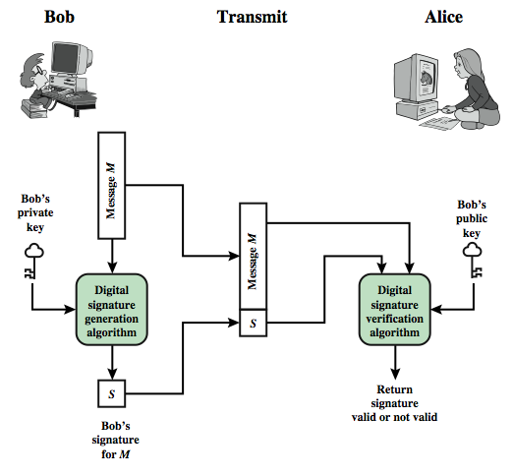
Digital Signature Model
Notes:
Stallings Figure 13.1 is a generic model of the process of making and using digital signatures. Bob can sign a message using a digital signature generation algorithm. The inputs to the algorithm are the message and Bob's private key. Any other user, say Alice, can verify the signature using a verification algorithm, whose inputs are the message, the signature, and Bob's public key.

Slide 19
Direct Digital Signatures
involve only sender & receiver
assumed receiver has sender’s public-key
digital signature made by sender signing entire message or hash with private-key
can encrypt using receivers public-key
important that sign first then encrypt message & signature
security depends on sender’s private-key
Notes:
The term direct digital signature refers to a digital signature scheme that involves only the communicating parties (source, destination). It is assumed that the destination knows the public key of the source. Direct Digital Signatures involve the direct application of public-key algorithms involving only the communicating parties. A digital signature may be formed by encrypting the entire message with the sender’s private key, or by encrypting a hash code of the message with the sender’s private key. Confidentiality can be provided by further encrypting the entire message plus signature using either public or private key schemes. It is important to perform the signature function first and then an outer confidentiality function, since in case of dispute, some third party must view the message and its signature. But these approaches are dependent on the security of the sender’s private-key. Will have problems if it is lost/stolen and signatures forged. The universally accepted technique for dealing with these threats is the use of a digital certificate and certificate authorities. We defer a discussion of this topic until Chapter 14, and focus in this chapter on digital signature algorithms. Also need time-stamps and timely key revocation.

Slide 20
Private Key Distribution system
symmetric schemes require both parties to share a common secret key
issue is how to securely distribute this key
whilst protecting it from others
frequent key changes can be desirable
often secure system failure due to a break in the key distribution scheme
Notes:
For symmetric encryption to work, the two parties to an exchange must share the same key, and that key must be protected from access by others. Furthermore, frequent key changes are usually desirable to limit the amount of data compromised if an attacker learns the key. This is one of the most critical areas in security systems - on many occasions systems have been broken, not because of a poor encryption algorithm, but because of poor key selection or management. It is absolutely critical to get this right!

Slide 21
Private Key Distribution system
given parties A and B have various key distribution alternatives:
A can select key and physically deliver to B
third party can select & deliver key to A & B
if A & B have communicated previously can use previous key to encrypt a new key
if A & B have secure communications with a third party C, C can relay key between A & B
Notes:
The strength of any cryptographic system thus depends on the key distribution technique. For two parties A and B, key distribution can be achieved in a number of ways:
Physical delivery (1 & 2) is simplest - but only applicable when there is personal contact between recipient and key issuer. This is fine for link encryption where devices & keys occur in pairs, but does not scale as number of parties who wish to communicate grows (see next slide). 3 is mostly based on 1 or 2 occurring first, and also suffers that if an attacker ever succeeds in gaining access to one key, then all subsequent keys will be revealed.
A third party, whom all parties trust, can be used as a trusted intermediary to mediate the establishment of secure communications between them (4). Must trust intermediary not to abuse the knowledge of all session keys. As number of parties grow, some variant of 4 is only practical solution to the huge growth in number of keys potentially needed.

Slide 22
Distribution of Public Keys
can be considered as using one of:
public announcement
publicly available directory
public-key authority
public-key certificates
Notes:
Several techniques have been proposed for the distribution of public keys, which can mostly be grouped into the categories shown.

Slide 23
Public Announcement
users distribute public keys to recipients or broadcast to community at large
eg. append PGP keys to email messages or post to news groups or email list
major weakness is forgery
anyone can create a key claiming to be someone else and broadcast it
until forgery is discovered can masquerade as claimed user
Notes:
The point of public-key encryption is that the public key is public, hence any participant can send his or her public key to any other participant, or broadcast the key to the community at large. Its major weakness is forgery, anyone can create a key claiming to be someone else and broadcast it, and until the forgery is discovered they can masquerade as the claimed user.

Slide 24
Publicly Available Directory
can obtain greater security by registering keys with a public directory
directory must be trusted with properties:
contains {name,public-key} entries
participants register securely with directory
participants can replace key at any time
directory is periodically published
directory can be accessed electronically
still vulnerable to tampering or forgery
Notes:
A greater degree of security can be achieved by maintaining a publicly available dynamic directory of public keys. Maintenance and distribution of the public directory would have to be the responsibility of some trusted entity or organization. This scheme is clearly more secure than individual public announcements but still has vulnerabilities to tampering or forgery.

Slide 25
Public-Key Authority
improve security by tightening control over distribution of keys from directory
has properties of directory
and requires users to know public key for the directory
then users interact with directory to obtain any desired public key securely
does require real-time access to directory when keys are needed
may be vulnerable to tampering
Notes:
Stronger security for public-key distribution can be achieved by providing tighter control over the distribution of public keys from the directory. It requires users to know the public key for the directory, and that they interact with directory in real-time to obtain any desired public key securely. This scenario is attractive, yet it has some drawbacks. The public-key authority could be somewhat of a bottleneck in the system, for a user must appeal to the authority for a public key for every other user that it wishes to contact. As before, the directory of names and public keys maintained by the authority is vulnerable to tampering.

Slide 26
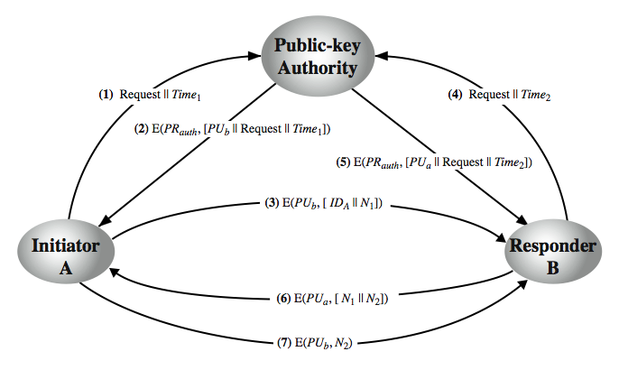
Public-Key Authority
Notes:
Stallings Figure 14.11 “Public-Key Authority” illustrates a typical protocol interaction. As before, the scenario assumes that a central authority maintains a dynamic directory of public keys of all participants. In addition, each participant reliably knows a public key for the authority, with only the authority knowing the corresponding private key. See text for details of steps in protocol. A total of seven messages are required. However, the initial four messages need be used only infrequently because both A and B can save the other's public key for future use, a technique known as caching. Periodically, a user should request fresh copies of the public keys of its correspondents to ensure currency.

Slide 27
Public-Key Certificates
certificates allow key exchange without real-time access to public-key authority
a certificate binds identity to public key
usually with other info such as period of validity, rights of use etc
with all contents signed by a trusted Public-Key or Certificate Authority (CA)
can be verified by anyone who knows the public-key authorities public-key
Notes:
An further improvement, first suggested by Kohnfelder, is to use certificates, which can be used to exchange keys without contacting a public-key authority, in a way that is as reliable as if the keys were obtained directly from a public-key authority. A certificate binds an identity to public key, with all contents signed by a trusted Public-Key or Certificate Authority (CA). A user can present his or her public key to the authority in a secure manner, and obtain a certificate. The user can then publish the certificate. Anyone needing this user's public key can obtain the certificate and verify that it is valid by way of the attached trusted signature. A participant can also convey its key information to another by transmitting its certificate. Other participants can verify that the certificate was created by the authority, provided they know its public key.
One scheme has become universally accepted for formatting public-key certificates: the X.509 standard. X.509 certificates are used in most network security applications, including IP security, secure sockets layer (SSL), secure electronic transactions (SET), and S/MIME. Will discuss it in much more detail later.

Slide 28
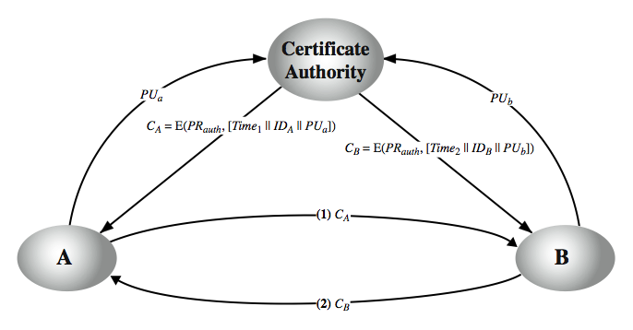
Public-Key Certificates
Notes:
A certificate scheme is illustrated in Stallings Figure 14.12. Each participant applies to the certificate authority, supplying a public key and requesting a certificate. Application must be in person or by some form of secure authenticated communication. For participant A, the authority provides a certificate CA. A may then pass this certificate on to any other participant, who can read and verify the certificate by verifying the signature from the certificate authority. Because the certificate is readable only using the authority's public key, this verifies that the certificate came from the certificate authority. The timestamp counters the following scenario. A's private key is learned by an adversary. A generates a new private/public key pair and applies to the certificate authority for a new certificate. Meanwhile, the adversary replays the old certificate to B. If B then encrypts messages using the compromised old public key, the adversary can read those messages. In this context, the compromise of a private key is comparable to the loss of a credit card. The owner cancels the credit card number but is at risk until all possible communicants are aware that the old credit card is obsolete. Thus, the timestamp serves as something like an expiration date. If a certificate is sufficiently old, it is assumed to be expired.
One scheme has become universally accepted for formatting public-key certificates: the X.509 standard.

Slide 29
Thank you….

